Slide 1

REDISCOVERING
OUR IDENTITY
A REVIEW OF ACTS
.

Slide 2

C&YA must be a praying ministry.

Slide 3
C&YA must be a praying ministry.
Acts 1:8 But ye shall receive power, after that the Holy Ghost is come upon you: and ye shall be witnesses unto me both in Jerusalem, and in all Judaea, and in Samaria, and unto the uttermost part of the earth.

Slide 4
C&YA must be a praying ministry.
Acts 1:8 But ye shall receive power, after that the Holy Ghost is come upon you: and ye shall be witnesses unto me both in Jerusalem, and in all Judaea, and in Samaria, and unto the uttermost part of the earth.
Act 1:12 Then returned they unto Jerusalem from the mount called Olivet, which is from Jerusalem a sabbath day's journey. 13 And when they were come in, they went up into an upper room, where abode both Peter, and James, and John, and Andrew, Philip, and Thomas, Bartholomew, and Matthew, James [the son] of Alphaeus, and Simon Zelotes, and Judas [the brother] of James. 14 These all continued with one accord in prayer and supplication, with the women, and Mary the mother of Jesus, and with his brethren.

Slide 5
C&YA must be a praying ministry.
Act 2:42 And they continued stedfastly in the apostles' doctrine and fellowship, and in breaking of bread, and in prayers...And the Lord added to the church daily such as should be saved.

Slide 6

C&YA must be a prepared ministry.

Slide 7
C&YA must be a prepared ministry.
Prepared through Sovereign Oversight

Slide 8
C&YA must be a prepared ministry.
Prepared through Sovereign Oversight
In Acts 2 the apostles were mocked.
In Acts 4 they were detained and threatened
In Acts 5 they were beat
In Acts 7 Stephen was stoned to death

Slide 9
C&YA must be a prepared ministry.
Prepared through Sovereign Oversight
Act 8:1 And Saul was consenting unto his death. And at that time there was a great persecution against the church which was at Jerusalem; and they were all scattered abroad throughout the regions of Judaea and Samaria, except the apostles.

Slide 10
C&YA must be a prepared ministry.
Prepared through Personal Surrender

Slide 11
C&YA must be a prepared ministry.
Prepared through Personal Surrender
Act 2:40 And with many other words did he testify and exhort, saying, Save yourselves from this untoward generation. 41 Then they that gladly received his word were baptized: and the same day there were added [unto them] about three thousand souls. 42 And they continued stedfastly in the apostles' doctrine and fellowship, and in breaking of bread, and in prayers.

Slide 12
C&YA must be a prepared ministry.
Prepared through Personal Surrender
Act 11:22 Then tidings of these things came unto the ears of the church which was in Jerusalem: and they sent forth Barnabas, that he should go as far as Antioch. 23 Who, when he came, and had seen the grace of God, was glad, and exhorted them all, that with purpose of heart they would cleave unto the Lord. 24 For he was a good man, and full of the Holy Ghost and of faith: and much people was added unto the Lord. 25 Then departed Barnabas to Tarsus, for to seek Saul: 26 And when he had found him, he brought him unto Antioch. And it came to pass, that a whole year they assembled themselves with the church, and taught much people. And the disciples were called Christians first in Antioch.

Slide 13

C&YA must be a giving ministry.

Slide 14
C&YA must be a giving ministry.
Act 2:42 And they continued stedfastly in the apostles' doctrine and fellowship, and in breaking of bread, and in prayers. 43 And fear came upon every soul: and many wonders and signs were done by the apostles. 44 And all that believed were together, and had all things common; 45 And sold their possessions and goods, and parted them to all [men], as every man had need.

Slide 15
C&YA must be a giving ministry.
Act 11:27 And in these days came prophets from Jerusalem unto Antioch. 28 And there stood up one of them named Agabus, and signified by the Spirit that there should be great dearth throughout all the world: which came to pass in the days of Claudius Caesar. 29 Then the disciples, every man according to his ability, determined to send relief unto the brethren which dwelt in Judaea: 30 Which also they did, and sent it to the elders by the hands of Barnabas and Saul.

Slide 16
C&YA must be a giving ministry.
2Co 8:1 Moreover, brethren, we do you to wit of the grace of God bestowed on the churches of Macedonia; 2 How that in a great trial of affliction the abundance of their joy and their deep poverty abounded unto the riches of their liberality.

Slide 17
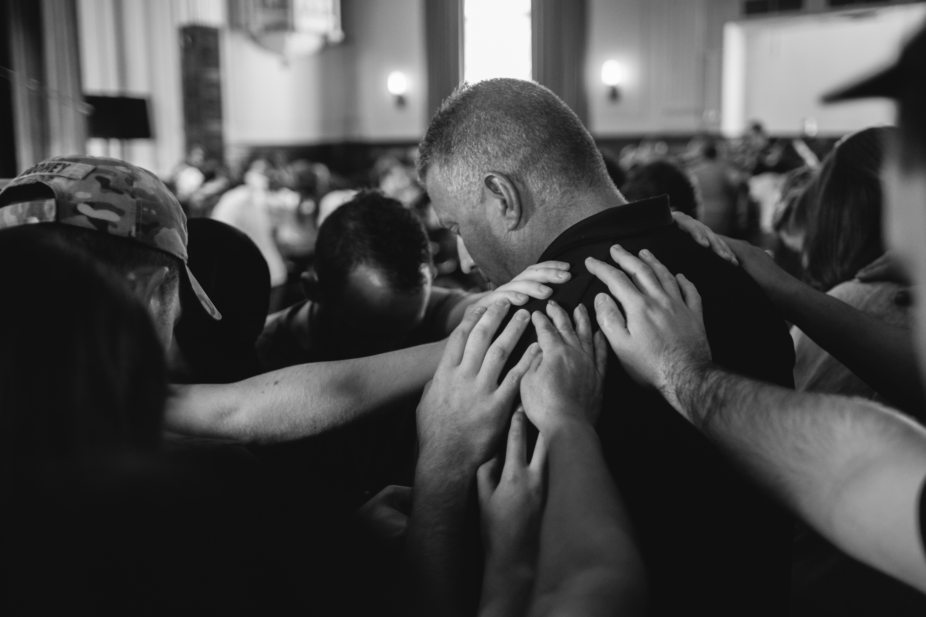
C&YA must be a going ministry.

Slide 18
C&YA must be a going ministry.
Act 1:8 But ye shall receive power, after that the Holy Ghost is come upon you: and ye shall be witnesses unto me both in Jerusalem, and in all Judaea, and in Samaria, and unto the uttermost part of the earth.

Slide 19
Pray for C&YA

